Slide 1

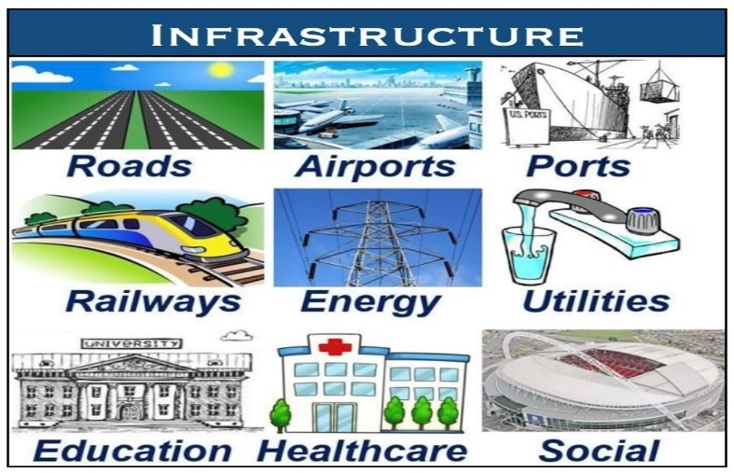
Infrastructure Concession Regulatory Commission
PPP Structure Investment – ASM/SSM Financing Options in the Optimization of Nigeria’s Mineral Resources Development
By
Dr. Amanze Okere
Infrastructure Concession Regulatory Commission, Abuja
15th February, 2024
Delivered at the 2nd 2024 Monthly Women in Mining Training Institute (WIMTI) Class

Slide 2

WIMTI CLASS, February 2024

Slide 3
Outline
ASM / SSM
Public Private Partnerships
Legal, Institutional & Legal Framework (ICRC Act, Role, Functions, Power, National Policy on PPP)
Nigeria’s PPP Journey
Typical Structure of PPP / PPP Lifecycle in Line with National Policy
Proposed Way Forward

Slide 4
ASM / SSM
Artisanal and Small-Scale Mining (ASM) is a term used in the mining sector to refer to the form of mining carried out by individuals, groups, families or cooperatives with a minimal level of mechanisation ASM refers to low-tech, labour-intensive method of mineral extraction and processing. The occupation is characterised by low incomes, serious environmental impacts, exposure to hazardous materials and conflict with larger companies and governments (Financing Artisanal and Small Scale Mining for Sustainable Rural Development in Sub-Saharan Africa –Olushola D. Eniowo).

Slide 5

ASM / SSM Cont’d
From Wikipedia, the free encyclopedia:
An artisanal miner or small-scale miner (ASM) is a subsistence miner who is not officially employed by a mining company, but works independently, mining minerals using their own resources, usually by hand.^{[1]}
Small-scale mining includes enterprises or individuals that employ workers for mining, but generally still using manually-intensive methods, working with hand tools.
Artisanal mining can include activities as simple as panning for gold in rivers, to as complex as development of underground workings and small-scale processing plants.

Slide 6
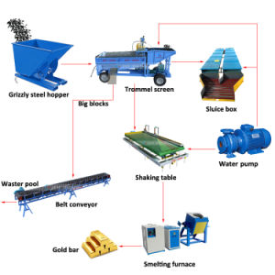
Some ASM / SSM Processes

Slide 7
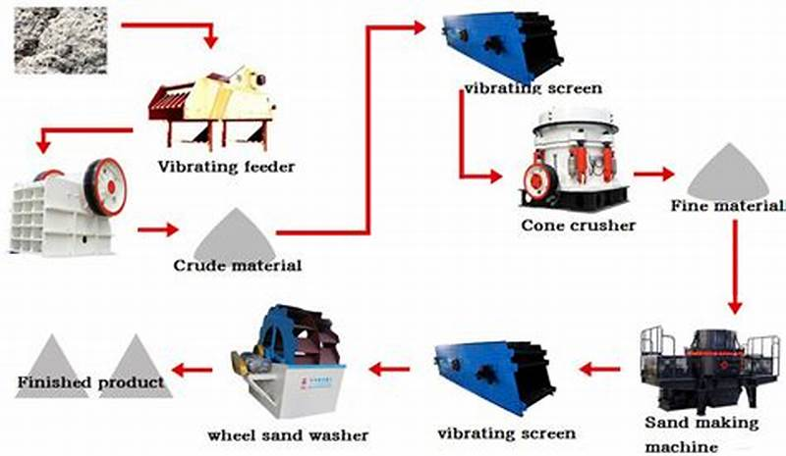
Some ASM / SSM Processes Cont’d

Slide 8
Some Basic terms
Formalization – The process of bringing informal income-earning activities and economies into the formal sector through legal, regulatory, and policy frameworks, as well as the extent to which such laws and regulations are successfully activated, implemented, and enforced by the relevant authorities.
Formal ASM – Operations that have the requisite licenses and permits required by law, and conform to regulations, policies and management practices.
Informal ASM – Operations that do not have the requisite licenses and permits required by law, but through social and cultural norms, rules and practices that have developed over many decades have a “social license to operate” from the local community, or other local actors who do not have power or authority vested by the state to award mineral rights, concessions, and permissions to mine.

Slide 9

Some Basic terms Cont’d
Legalization / regularization – The legality refers only to the legal regulatory framework that makes ASM legal.
Licensed and legal ASM – Operations that have a mining license and any environmental permits and permissions as required by law.
Unlicensed / illegal ASM – Operations that do not have a mining license and any environmental permits and permissions as required by law.

Slide 10
Financing Instruments in Mining
Financing small-scale mining projects requires a solid understanding of the various financial instruments available and the significant role that capital investments play. One must assess the financial methods that align with both the risks and potential rewards of the mining project.
Equity Financing: Investors provide capital to mining companies in exchange for ownership stakes. This form of financing is crucial for companies that do not yet generate revenue or for those looking to expand operations without increasing debt levels.
Debt Financing: Involves loans that must be repaid with interest. Miners often secure such loans using their assets or the resources they expect to extract. It’s a common choice for operations looking to fund expansions or new equipment purchases.

Slide 11
Financing Instruments in Mining Cont’d
Streaming and Royalty Agreements: A prevalent form of alternative mine financing, where investors provide upfront capital in exchange for a percentage of future production or revenues.
Production-Linked Lending: A financial model especially useful for base and precious metals, which ties the repayment of loans to the level of production from the mining operation, providing a degree of flexibility in the repayment structure.
Joint Ventures: These agreements involve multiple parties pooling resources to share the risks and rewards of mining projects, effectively spreading the financial burden.
Public Private Partnerships….

Slide 12
PPPs in Mining
Against the backdrop of capacity and resource constraints experienced by most African countries, the policy brief argues that African governments need to realise the benefits of partnering with the private sector in the exploitation and processing of natural resources. Consequently, they should formulate, facilitate and implement appropriate policies that promote joint ventures with the private sector. The private sector is technically equipped and financially resourced; it can stimulate innovation and improve productivity, wealth creation and distribution – critical achievements towards the realisation of the Millennium Development Goals (MDGs) of poverty alleviation and eradication of hunger in poor communities, which are the main developmental issues in Africa. (Public-Private Partnerships (PPPs) and Sustainable Natural Resources Exploitation in Africa: Lessons from Diamond Mining in Chiadzwa, Zimbabwe. Trynos Gumbo, Stellenbosch University, June 2013)

Slide 13
Definition of PPP
A Public-Private Partnership is a contractual agreement between a public agency (federal, state or local) and a private sector entity. Through this agreement, the skills and assets of each sector (public and private) are shared in delivering a service or facility for the use of the general public. In addition to the sharing of resources, each party shares in the risks and rewards potential in the delivery of the service and/or facility (Nat. Council on PPP USA)
Wide Infrastructure Gap
Small and depleting Government resources
Urgent need for alternative funding of Infrastructure
Growing demand for private sector participation in infrastructure
The goal is to combine the best capabilities of the public and private sectors for mutual benefit
13

Slide 14
Annexure 2
7 Essential Conditions That Define Public Private Partnerships
1
Arrangement
Between public & private
2
Provision
Of services for public benefit by private partner
3
Investments
In and/or management of public assets by private partner
4
Time Period
For a specified time
5
Risk Sharing
Optimally between contracting parties
6
Standards
Focus on quality of service / performance
7
Payments
Linked to performance
Source: IDFC
Notes:
The salient features of any PPP arrangement are as follows:
Contractual arrangement: Bring the public and private sector together to create better value for money for the taxpayers through the use of the management skills and financial strength of the private sector, and conducive legislative and policy measures of the public sector.
Substantial risk transfer to the private sector: Engage the private sector through a transparent process and oversee the PPP according to accepted performance norms.
Financial rewards based on performance: The government pays the private sector for the services it renders; these services are based on actual performance as against the targets.

Slide 15
Public Private Partnerships
… Key principles from National PPP Policy
Value for Money
Cost, risks and service quality
Public interest
Adequate consultation with end-users and other stakeholders
Output requirements
Clear and verifiable service standards for output specifications.
Transparency
Transparency and probity can reduce concerns over corruption.
Risk allocation
Risks allocated to the party best able to manage them.
Competition
Ensuring and enforcing adequate competition procedures & laws.
Capacity to deliver
Partners must have adequate capacity to deliver and manage the EPC & commercial processes

Slide 16
PPP PROJECTS MUST BE BANKABLE & AFFORDABLE
IRR > Weighted Average Cost of Capital
RoE > Shareholders Requirement
Debt Service Cover Ratio > Bankers or Lenders Requirements
Loan Life Cover Ratio > Bankers or Lenders Requirements
Focus on not just comparative but competitive advantage !!
Ideas don’t get funded bankable projects get funded.
You must take to market projects with robust cash flows and cost reflective returns

Slide 17
Traditional Risk Allocation

Slide 18
PPP- Risk Allocation

Slide 19
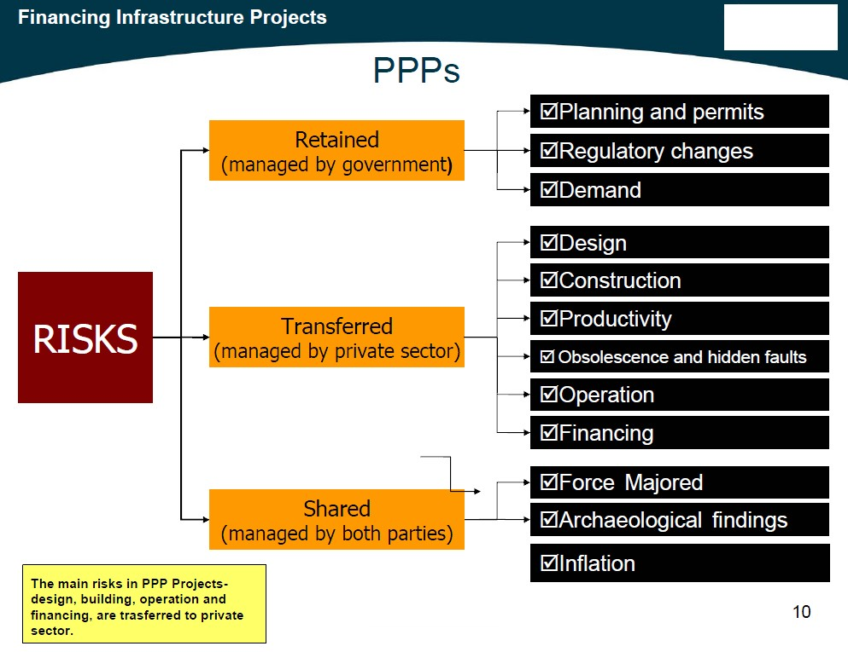
Risk Allocation in PPP Projects

Slide 20
Typology of PPPs
FINANCIALLY FREE STANDING PROJECTS Examples -Toll Roads/ Bridges, Telecom services, Port projects | Role of public sector - planning, licensing & statutory approvals No financial support/ payment is made by government Revenues are through levy of user charges by the private sector
PROJECTS WHERE GOVERNMENT PAYS FOR SERVICES Examples - Roads - annuity/ shadow tolls, power - under PPAs. In UK -prisons, education, health services, defence related services | Private sector paid a fee (tipping fee), tariff (shadow toll) or periodical charge (annuity) by Government for providing services The payment is made against performance There may be demand risk transfer – either in part or whole
Note that: In both cases, the design, financing, construction and O&M risks are fully that of the private partner
HYBRID STRUCTURES Example – toll road project with either viability gap payment by government or annuity payment based road contract with tolling rights | Combine the financially free standing nature – levy of a user charge – with payment by the public entity Payment could be as a viability gap subsidy or an annuity payment

Slide 21
Forms of PPPs
Service contracts:
  Private sector contracted for specific tasks
  Capital investment and ownership of the asset is by the public sector
  Public entity pays the private company for provision of services but retains the commercial risk
Management contracts:
  Private sector manages the utility but does not finance it
  Capital investment and ownership are retained by the public
  Public entity pays private manager a fixed management fee
  Commercial risk is held by the public
Lease:
  Private sector manages the utility and finances the O&M
  Capital investment and ownership are retained by the public
  Private operator collects revenues and pays to the public entity a fixed fee
  Commercial risk is shared

Slide 22
Forms of PPPs
Concession:
Private operator manages the utility and finances new investments as well as O&M
Capital investment is made by the private operator but ownership is retained by the public
Private operator collects revenues and may pay a concession fee to the public entity
Commercial risk is borne by the private operator
BOT ( and other variations e.g. BOOT, BTO, DBOT, DFBOT, etc)
Private operator builds new infrastructure, operates it for fixed period and transfers it to public sector
Capital investment is made by the private operator, but ownership is by both at different points in time
Public utility pays private operator for services provided by the new asset
Commercial risk is usually private, but could also be shared

Slide 23
Key Benefits of PPPs
Rigorous project preparation – since the focus shifts to developing bankable projects
Delivery of a whole life solution – going beyond asset creation and including Operation and Maintenance (O&M)
Focus shifts to service delivery – construction responsibility is integrated with O&M obligations and together with appropriate quality monitoring and service delivery-linked payments such an arrangement could enhance the levels of service delivery
It is possible to adopt a programmatic approach to infrastructure development and service delivery – various time bound projects can be integrated under a programme and have a time-bound implementation plan
Can lead to better overall management of public services – transparency in selection and ongoing implementation

Slide 24
Need for PPP Legal, Institutional & Regulatory Frameworks
To facilitate investments in PPP arrangements
Reduce transaction costs on the part of the public agency
Ensure appropriate regulatory controls
Enable the efficient and speedy resolution of contract disputes
Make PPP arrangements possible and functional
Typically defined in laws, regulations; policy documents, guidance notes, capacity building and through the design of PPP contracts.

Slide 25
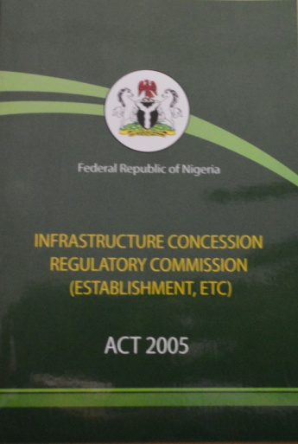
Infrastructure Concession Regulatory Commission Act, 2005
The ICRC Act, 2005 is the PRIMARY legislation guiding PPPs in Nigeria. Its jurisdiction covers PPPs executed by the Federal Government. Some key provisions are:
  MDAs may enter into contracts or grant concessions to private party for the financing, construction, operation, and maintenance of any Federal Government infrastructure that is financially viable , Section 1(1)
  Establishes ICRC , its Powers and Functions, Section 14, 19 & 20
  Competitive bidding for projects and Exceptions , Section 4 & 5
  Recovery of investment, Section 7
develop the guidelines, policies, and procurement processes for PPP
sets out processes and procedure for applying for and securing concessions in Nigeria
provides a basic framework in the form of guarantees of profitability of PPP projects
contracts completed in compliance with the Act will be legal and enforceable

Slide 26
Role of ICRC
TheICRC was established to:
  Regulate Public Private Partnership (PPP) by:
    Guiding MDAs in structuring PPP transactions for both greenfield and brownfield infrastructure – Pre-Contract regulation
    Taking custody of all executed agreements and ensuring compliance with the terms and conditions of such contracts –Post-Contract regulation
  Issue regulations and guidelines to ensure efficient PPP transactions
  Collaborate with state governments to develop sustainable framework for PPP

Slide 27
Functions and Powers of ICRC
Functions – Section 20
  Take custody and of every PPP contract/concession agreement and monitor compliance.
  Ensure efficient execution of any PPP contract/concession agreement entered by the Federal Government.
  Ensure compliance with the ICRC Act
Powers – Sections 10, 19 & 34
  Power to inspect
  Power to provide and manage general policies and guidelines of the Commission
  Power to make regulations

Slide 28
What Others Do
  Initiate PPP projects – MDA responsibility
  Develop the Projects – MDA responsibility
  Approve PPP projects – FEC approves
  Enforce court judgments over PPP transactions – Law Courts’ Mandate

Slide 29
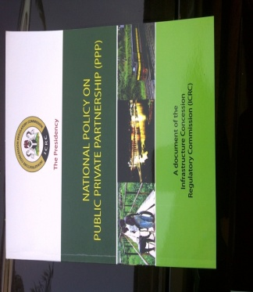
  National Policy on Public Private Partnership
In April 2009, the Federal Executive Council (FEC) approved a National Policy on PPP which provides guidance on PPP project development, structuring and implementation.
The Policy sets out:
  The government objectives and commitments with regards to PPP
  The Key principles of PPPs in the Nigerian context
  The government’s role in the creation of an enabling environment
  The processes in the PPP project lifecycle
Establishes the:
PPP Resource Centre – policy, advisory and transaction structuring
Compliance Committee – to take custody of agreements and monitor compliance

Slide 30

Nigeria’s PPP Journey
Between 2010 and December 2023, the Federal Government of Nigeria, through FEC, approved 103 PPP projects worth over NGN 20 Trillion
As at December 2023, there are 95 post-contract PPP projects at different stages of the implementation phase. These are successful PPP projects
As at December 2023, there are over 152 pre-contract projects at different Development and Procurement stages
In 2015, received the award of the best PPP regulator in Africa
With the support of the World Bank, made Nigeria the first in the World to launch a globally accepted project disclosure portal in 2017

Slide 31
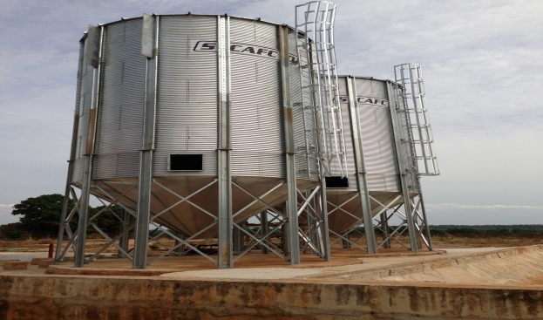
Nigeria’s PPP Journey
As at December 2023, ICRC has issued 199 Outline Business Case Compliance Certificates to different MDAs, confirming viability and bankability to proceed to procurement phase
As at December 2023, ICRC has also issued 116 Full Business Case Compliance Certificates to different MDAs, in order to obtain FEC approval to sign PPP contracts
ICRC gazetted in 2022, a pipeline of 56 eligible and bankable PPP projects, worth about USD 22 Billion, containing projects from different economic sectors which have been granted the Outline Business Case Compliance Certificates, but which do not have identified bidders.

Slide 32
Nigeria’s PPP Journey – The NII3P
ICRC has established a capacity building arm known as the Nigeria Institute of Infrastructure and Public Private Partnership (NII3P), to focus on PPP trainings for MDAs
The NII3P is involved in Basic, Intermediate and Advanced PPP trainings, as well as Short courses in Infrastructure Development - on topics including but not limited to Project Finance, Capital Market, Arbitration and other legal issues, Banking, Risk Management, Financial Modelling, Project Management, etc; with resource persons drawn from experienced industry experts.

Slide 33
Nigeria’s PPP Journey – The NII3P
The Institute is collaborating with reputable organizations to deliver the global APMG Certified PPP Professional courses on Foundation, Preparation and Execution; and is also undertaking an MBA in PPP training programme, in collaboration with Malaysia University of Science and Technology.
The PhD programme will commence shortly

Slide 34
Nigeria’s PPP Journey – The 3PUCF / NPPPN
The ICRC coordinates the Public Private Partnership Units Consultative Forum (3PUCF), a forum for Heads of PPP Units in Federal Ministries, Departments and Agencies; for knowledge and experience sharing ensuring symmetry of effort towards institutionalizing the Federal Government’s PPP programme, provision of training and educational intervention among others. The 3PUCF is chaired by the Head of the Civil Service of the Federation; and meets every quarter
In addition, the ICRC coordinates the activities of the Nigeria Public Private Partnership Network (NPPPN), under the Chairmanship of the Nigeria Governor Forum (NGF). This is a platform for all States Heads of PPP Units nationwide, which was established to serve as a knowledge and experience sharing forum to upscale the learning curve of public sector officers at the subnational level of government. It was also aimed to provide standardization of PPP practice and enhance collaboration within and among subnational PPP entities nationwide. The NPPPN is also scheduled to meet once in every quarter

Slide 35
7 Essential Conditions That Define Public Private Partnerships
Typical Structure of Public Private Partnerships
BOT- Airport Transit Rail Project
The final responsibility for service delivery continues to remain with the public sector agency
GRANTING AGENCY
FINANCIERS
Equity Investors
Concession Agreement
Equity Investors
Finance Ris
Lenders, Guarantors Insurers
FINANCIERS
Equity Investors, Lenders, Guarantors, Insurers
SPV
Service
USERS
Fees
Design Risk
Construction Risk
Operational Risks
Traffic/Revenue & O&M
Demand, Traffic,
Demand, Traffic,
Risk
Risk
Design Consultant
Construction Contractor
O&M Contractor
CONSTRUCTION
DESIGN
CONTRACTOR
CONTRACTOR
CONSULTANT
Notes:
The salient features of any PPP arrangement are as follows:
Contractual arrangement: Bring the public and private sector together to create better value for money for the taxpayers through the use of the management skills and financial strength of the private sector, and conducive legislative and policy measures of the public sector.
Substantial risk transfer to the private sector: Engage the private sector through a transparent process and oversee the PPP according to accepted performance norms.
Financial rewards based on performance: The government pays the private sector for the services it renders; these services are based on actual performance as against the targets.

Slide 36

PPP LIFECYCLE in line with National Policy
Project Identification
Project Prioritization
Project Selection
Preliminaries
Development Phase
Procurement Phase
Implementation Phase
TRANSACTION ADVISER
NEEDS ANALYSIS
PPP OPTIONS APPRAISAL
VALUE FOR MONEY
AFFORDABILITY
SUSTAINABILITY
PRELIM RISK MATRIX
VIABILITY/BANKABILITY
VGF
OBC
OBC Certification by ICRC
TRANSACTION ADVISER
EoI/RFQ Phase AND RFP
BIDDING
BIDDERS CONFERENCE
BID EVALUATION
VALUE FOR MONEY TEST
PREFERRED BIDDER
FULL BUSINESS CASE
BY FEC
INDEPENDENT ENGINEER
MONITOR DESIGN AND
CONSTRUCTION
COMMISSIONING TEST
VERIFY OUTPUT
REQUIREMENTS
CONTRACT MANAGEMENT
PREPARING AND IMPLEMENTING EFFICIENT
AND EFFECTIVE PPP TRANSACTIONS

Slide 37
The Nigerian PPP Framework
… The SOLICITED PPP Process -1
OBC
Project Prepared
Project Identified
Project identification by MDAs
MDA’s engages ICRC prior to commencing PPP to ensure viability and bankability of proposed projects.
MDA’s consult and engage with the FMoF to structure financing prior to commencing PPP projects
MDA engage Transaction Adviser (TA) as required under the Public Procurement Act of 2007. Prepares for Outline Business Case (OBC) ICRC reviews OBC/issues OBC Certificate of Compliance

Slide 38
The Nigerian PPP Framework
… The SOLICITED PPP Process II
5. Upon OBC Certification, MDA’s/TA
commence procurement of private partner.
6. Upon procurement, MDA negotiates with
preferred investor and submit Full Business
Case (FBC) to ICRC for FBC Certificate of
Compliance.
MDA submit FBC to FEC for approval.
Upon approval, PPP contract is signed and ICRC takes custody
MDA and preferred PPP Project Proponent (Investor) achieve Financial Close.
ICRC and the MDA conduct regular joint Inspections of the Project until the end of the contract.
Project Implemented
Investor Procured
FBC

Slide 39
Proposed Way Forward
Practising members of WIMTI should set themselves up as Cooperative Society
The Cooperative Society should obtain necessary registration approvals as a legal entity
The Cooperative Society should identify ASM/SSM projects they can execute, especially low hanging fruits projects
This should be followed by developing the necessary PPP Outline Business Case (OBC)
The OBC should be submitted to the Ministry of Solid Minerals, who will in turn review, accept to own and submit same ICRC as an Unsolicited PPP proposal
ICRC will provide the necessary PPP regulatory guidance, leading to Financial Close
This should be undertaken with adequate knowledge and guidance of the relevant sector regulator

Slide 40

Infrastructure Concession Regulatory Commission
Plot 1270 Ayangba Street, Near FCDA Headquarters,
Area 11, Garki, Abuja – Federal Capital City.
Phone: +234 9-4604900, E-mail: nii3p@icrc.gov.ng, info@icrc.gov.ng
Website: www.icrc.gov.ng

