Slide 1
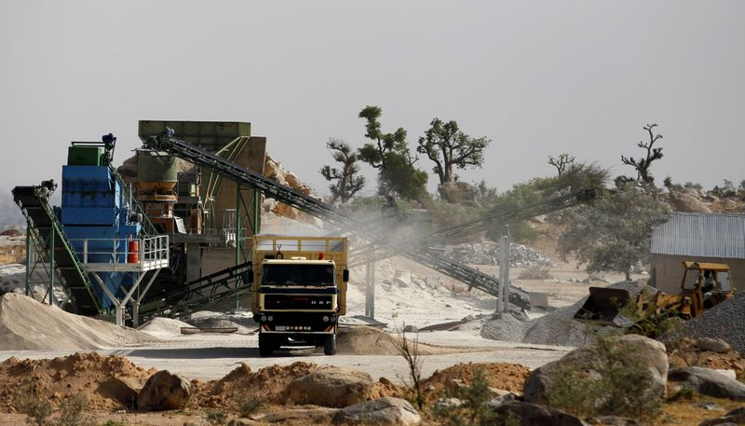
The Downstream Business Opportunities in Nigeria Mining Ecosystem
By
Engr. Fatai Jimoh
CEO of HNF Global Resources Ltd

Slide 2
Overview of the Nigeria Mining Ecosystem
The Nigeria mining ecosystem encompasses various elements related to the mining industry in Nigeria. It includes:
Minerals and Resources: Nigeria is rich in various mineral resources, including solid minerals like limestone, gypsum, coal, tin, columbite, gold, and more. It has significant potential for economic development through mining.
Government Regulation: The mining sector in Nigeria is regulated by government agencies like the Ministry of Mines and Steel Development (MMSD) and the Mining Cadastre Office (MCO). The government sets policies, issues licenses, and regulates the industry.
Challenges: The Nigerian mining ecosystem faces challenges such as illegal mining, inadequate infrastructure, lack of investment, environmental issues, and inconsistent policies.
Investment Opportunities: Despite challenges, there are opportunities for both local and foreign investors to participate in exploration and mining activities in Nigeria.
Artisanal and Small-Scale Mining (ASM): ASM plays a significant role in the Nigerian mining ecosystem, though it often operates informally. It provides livelihoods for many, but there are concerns about safety, environmental impact, and revenue leakage.

Slide 3
International Collaboration: Nigeria collaborates with international organizations and stakeholders to promote responsible and sustainable mining practices.
Mineral Processing and Value Addition: Nigeria is looking to develop its mineral processing and value addition capabilities to maximize the benefits from its mineral resources
Geological Potential: Nigeria's geology is diverse, offering potential for various minerals and resources, which, if properly harnessed, could drive economic growth.
Sustainability and Environmental Concerns: Ensuring sustainable and environmentally responsible mining practices is a priority in the ecosystem.
Local Communities: Mining activities often intersect with local communities, and community engagement and development are vital aspects of the ecosystem.
Research and Development: Investment in research and development is crucial to improving mining technologies and practices.

Slide 4
Current Status of Downstream Business Opportunities
1
Mineral Processing
Exploration, extraction, and refining of minerals offer business opportunities in sectors like cement, ceramics, and metal production.
2
Manufacturing & Construction Materials
The mining industry fuels demand for construction materials like iron rods, cement, and tiles, creating business opportunities in manufacturing and construction sectors.
3
Energy & Power Generation
Mining provides raw materials for energy production, enabling downstream businesses in power generation, renewables, and oil refining.

Slide 5
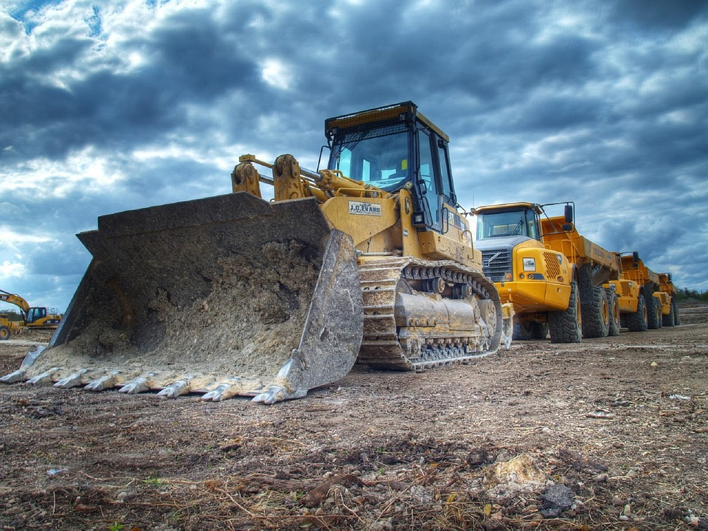
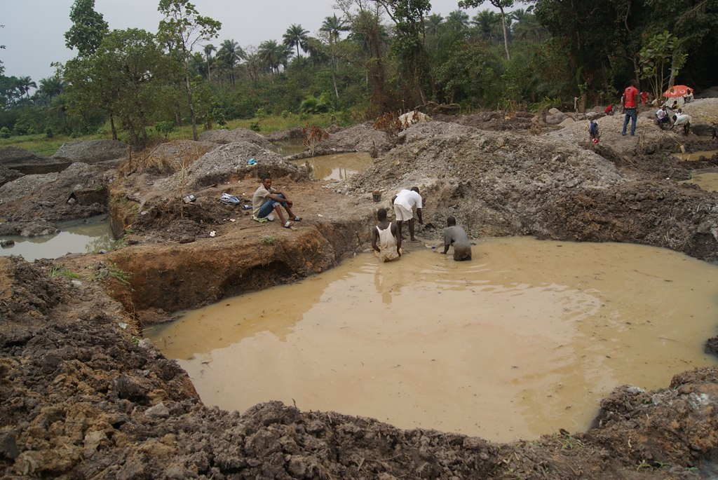
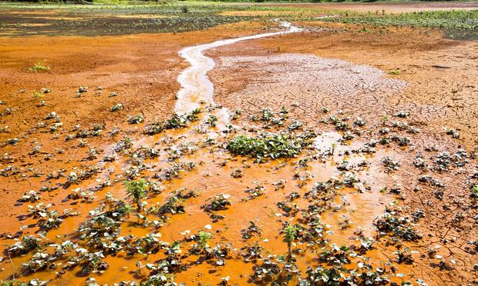
Exploring the Potential of Downstream Business Opportunities
Equipment Manufacturing
Artisanal Mining
Waste Management
Promote formalization of artisanal mining to unlock its potential for employment and wealth creation.
Develop sustainable solutions for managing mining waste, such as recycling and repurposing.
Investing in the production of mining equipment can meet local demand and create export opportunities.

Slide 7
Challenges and Risks in the Nigeria Mining Ecosystem
1
Infrastructure Deficit
2
Regulatory Complexity
3
Security Concerns
Addressing security risks associated with illegal mining activities is vital for sustainable growth.
Inadequate transportation and power infrastructure pose challenges for efficient mining and downstream operations.
Navigating complex regulatory frameworks and obtaining permits can be challenging for businesses.

Slide 8
Government Initiatives and Policies to Support Downstream Business
1
Policy Reforms
The government is implementing reforms to enhance the ease of doing business in the mining sector.
2
Investment Incentives
Incentives like tax holidays, royalty free month, and access to funding are provided to attract investors to the mining industry.
3
Capacity Building
The government aims to enhance the skills and knowledge of local workforce through training programs.

Slide 9
Conclusion and Recommendations
Downstream businesses have vast opportunities in the Nigeria mining ecosystem.
Government support, infrastructure development, and policy reforms are key to unlocking the full potential of the industry.
Investors should consider collaboration, innovation, and sustainable practices to thrive in this evolving landscape.

Slide 10
THANKS FOR LISTENING

