Slide 1
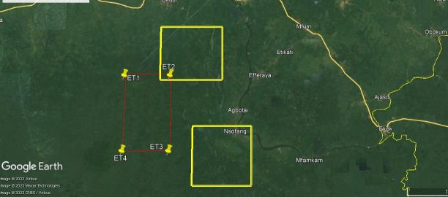
THE USE OF SOFTWARES IN THE DIGITALIZATION OF MINING IN NIGERIA - PROMOTING GENDER EQUALITY
MICHELLE O. NWAFOR

Slide 2
OVERVIEW
01.
Introduction
04.
Hurdles to Accessing Technological Literacy
05.
The Role of Women in the Digitalization of the Mining Sector
02.
Digitalization : Tools, Types
03.
Softwares used in the Mining Sector
06.
Conclusion

Slide 3
INTRODUCTION
The mining industry is an important industry in any country which has solid minerals as it supports approximately 45% of the world’s economic activities, making it a critical part of multiple production chains.
Mining techniques and technologies have evolved and improved over time with the introduction of digital technologies
Digitalization is defined as the convergence of the real world with the virtual world. Applied to mining, this means transforming analog processes and physical objects into digital ones.
The use of various softwares has improved the productivity of various mines. The interest in smart mining has seen more companies investing in Artificial Intelligence, Internet of Things and other advanced technology thereby making mining more lucrative.
The quest for a greener and more sustainable mining industry has seen a growth in digitalization in the mining sector.

Slide 4
DIGILITALIZATION TOOLS
Digitalisation in mining refers to the use of computerized or digital devices or systems and digitized data that reduce costs, improve business productivity, and transform mining practices.
Taking up digital alternatives can offer additional income, additional employment opportunities and improved access to knowledge and general information that benefit women and girls.
The Internet
The Internet improves information flows and lowers hurdles to accessing both general and specific knowledge, including about education and training possibilities
.
Digital Platforms
-Economic platform; online banking
-Digital labor platform; upwork, freelancer
-Ride Services; Uber, Bolt
Cloud Computing

Slide 5
Spatial data visualisation
Three-dimensional (3D) Modelling
Virtual Reality (VR
Augmented Reality (AR)
Geographic information systems
Artificial intelligence
Automated drones

Slide 6
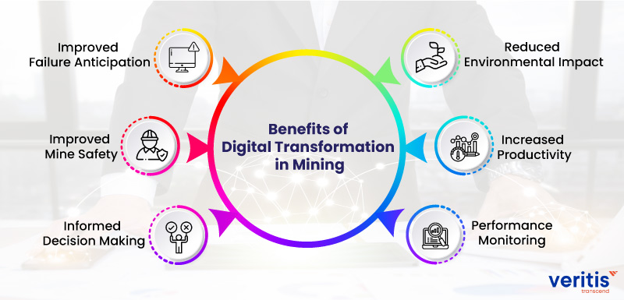
Benefits of Digital Transformation in Mining
Source: Veritas Transcend

Slide 7
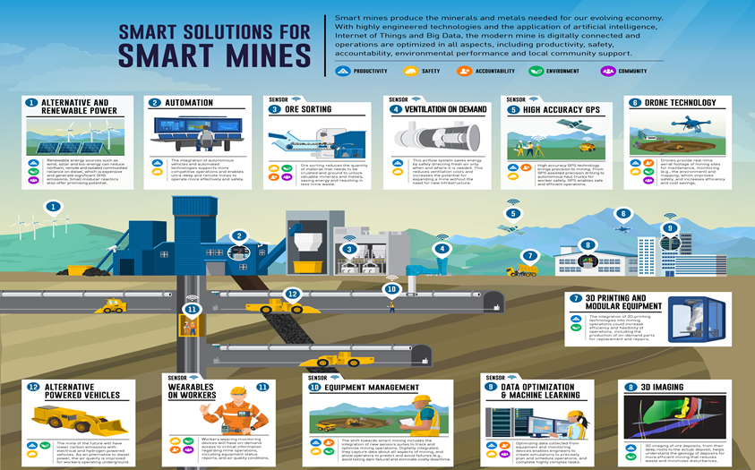

Slide 8
SOFTWARES USED IN THE MINING SECTOR
ArcGis
IPI2WIN
Map Source
ENVI
Global Mapper
ERDAS IMAGINE
Rock Works
Geomative Studio
Geovia Surpac
Oasis Montaj

Slide 9
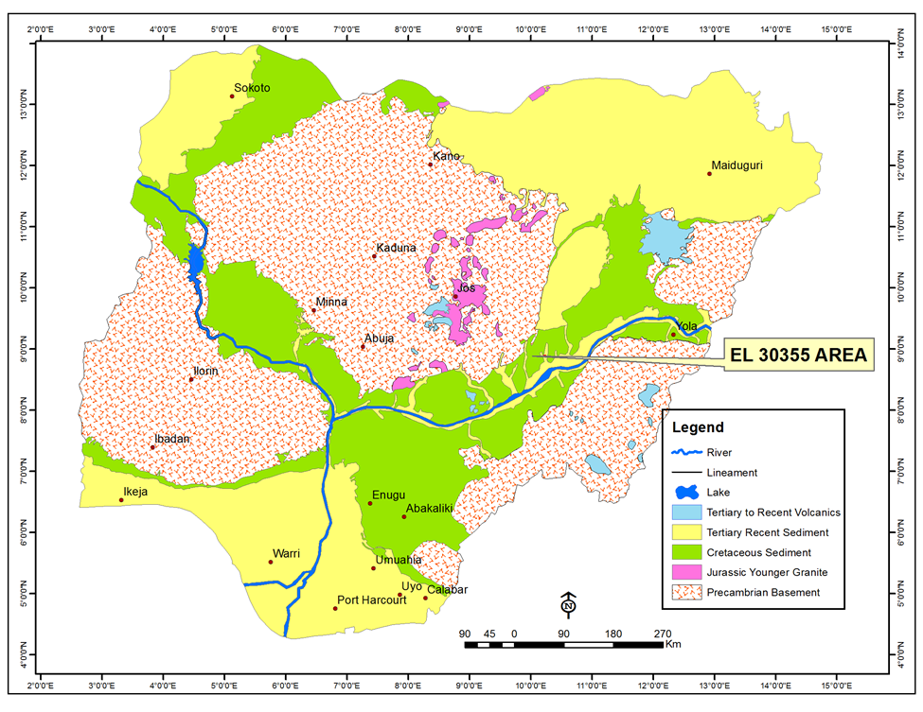
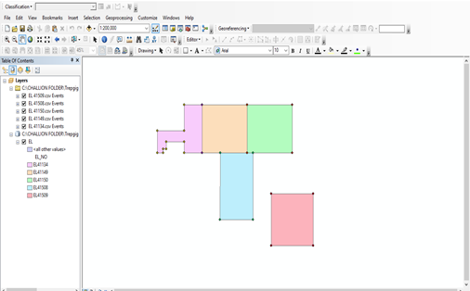
Data from the field processed using various softwares

Slide 10
HURDLES TO ACCESSING TECHNOLOGICAL LITERACY
Lack of Literacy and Digital skills
Limited Access to Internet and digital devices
Limited Finance
Limited Finance
Lack of Electricity in some remote areas
Social and Cultural Exposure
Fear

Slide 11
Source: MiHR 2018

Slide 12
THE ROLE OF WOMEN IN THE DIGITALIZATION OF THE MINING SECTOR
UN Women describes gender equality as follows: Equality between women and men (gender equality): refers to the equal rights, responsibilities and opportunities of women and men and girls and boys. Equality does not mean that women and men will become the same but that women’s and men’s rights, responsibilities and opportunities will not depend on whether they are born male or female
Women have a major role to play in the digitalization of the mining industry
The Mining industry is a male dominated industry where activities are focused mainly in the fields.
Using digital skills efficiently is one way in which women can make impact in the actualization of a safer and sustainable mining industry

Slide 13
CONCLUSION
In late 2016, BHP set a new target for women to make up half of its workforce by 2025, based on the conviction that the inclusion of more women would improve performance indicators. This target was – and remains – one of the most ambitious gender targets to be set by a global company.
With Nigeria ranking 139 out of 153 countries in the 2021 Global Gender Gap Report, these figures simply paint the uneven picture that while men are actively shaping Nigeria’s technology ecosystem, women are largely passive users.
Providing lasting solutions to solve the hurdles to accessing technological literacy will go a long way in improving digital literacy especially for women.
The growing interest in Smart mining will see an increase in the use of softwares and other digital tools to provide safer and sustainable mining practices.
In both Ghana and Tanzania, limited exploration of the zoned areas are being carried out to provide geo-data to ASM.

Slide 14
Thanks for Listening

